Slide 1
Cycling of Non-Self-Representing PSUs in the National Health Interview Survey
Presented at the Joint Statistical Meetings
August 5, 2024
Presenter: John Chesnut (U.S. Census Bureau)
Author: Padraic Murphy (U.S. Census Bureau)
Any views expressed are those of the authors and not those of the U.S. Census Bureau
The U.S. Census Bureau reviewed this data product for unauthorized disclosure of confidential information and approved the disclosure avoidance practices applied to this release. CBDRB-FY24-POP001-0085.

Slide 2
Two-stage Sample Design
Stage 1: Select PSUs
Stage 2: Select USUs
PSU = Primary Sample Unit
Examples: county, school district, farm
USU = Ultimate Sample Unit
Examples: address, school, acre

Slide 3
Outline
PSU Definitions (including SR/NSR type determination)
PSU Stratification
PSU Sample Selection
SR PSU Selection (simple)
NSR PSU Selection (complicated)
Annual NSR PSU sample size (number of PSUs, not HUs)
State twelve-year NSR sample sizes for cycling
Determination of “quasi-SR” (QSR) PSUs
Selection of non-QSR PSU sample
NSR Sample-year assignment
Calculation of PSU weights

Slide 4
PSU Definitions (including SR/NSR type)
NHIS 2020 Design PSU: county or group of counties
Starting point: NHIS 2010 “geographic areas”
PSU types
SR = “self-representing” – in sample with certainty every year
NSR = “non-SR” – a sample of NSR PSUs selected within each state to represent the NSR part of the state
In some states, we grouped counties to get the 2020 NSR PSUs closer to being equally sized (in terms of 2020 Census HU count)
SR cutoff: 200,000 HUs (per 2020 Census)
Exceptions – SR PSUs under 200K in some states (to reduce sampling variance and ease Field burden)

Slide 5
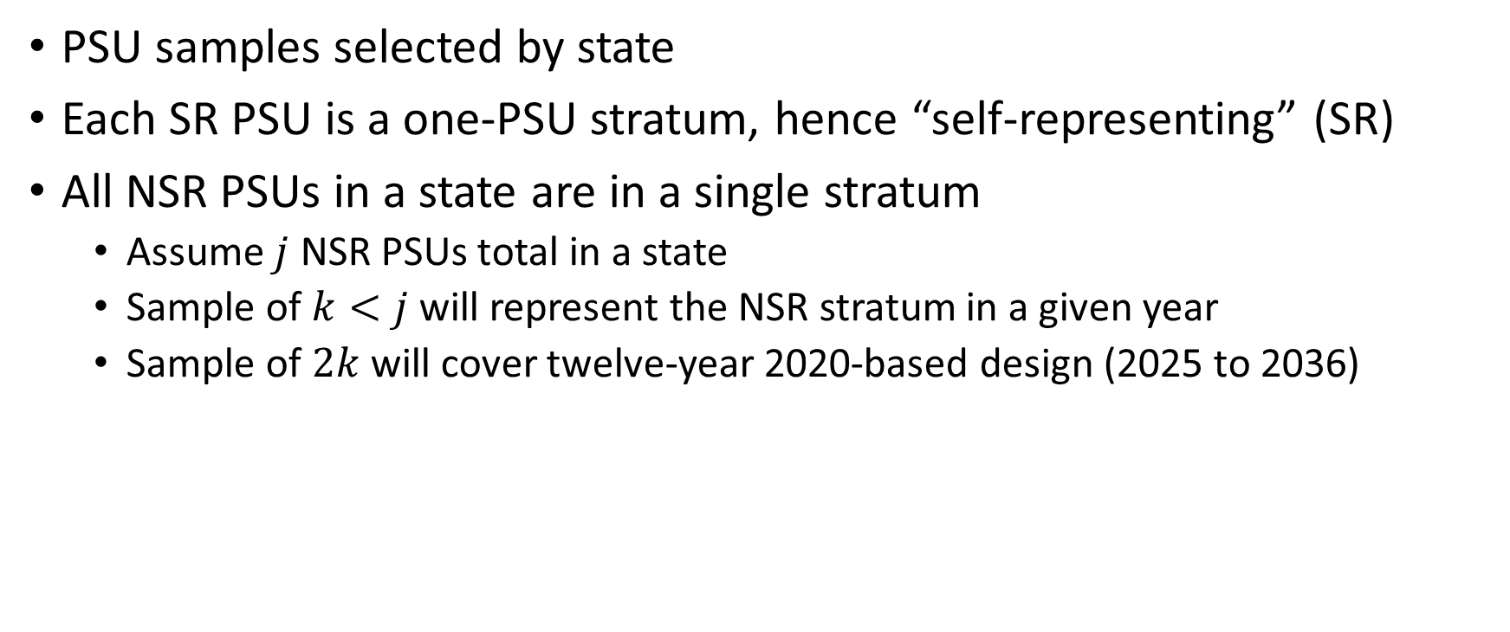
PSU Stratification
PSU samples selected by state
Each SR PSU is a one-PSU stratum, hence “self-representing” (SR)
All NSR PSUs in a state are in a single stratum
Assume $j$ NSR PSUs total in a state
Sample of $k<j$ will represent the NSR stratum in a given year
Sample of $2k$will cover twelve-year 2020-based design (2025 to 2036)

Slide 6
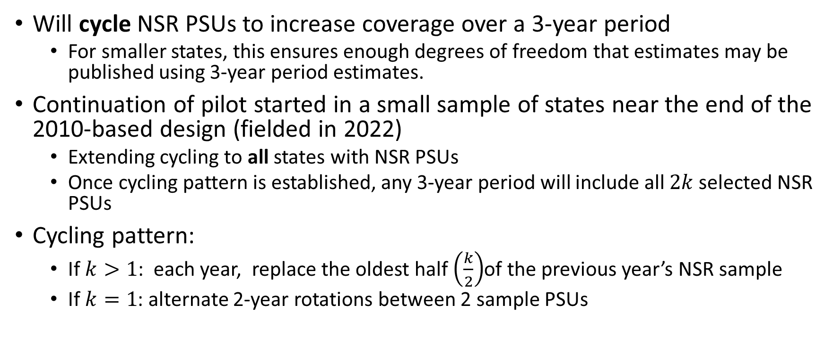
NSR PSU Cycling
Will cycle NSR PSUs to increase coverage over a 3-year period
For smaller states, this ensures enough degrees of freedom that estimates may be published using 3-year period estimates.
Continuation of pilot started in a small sample of states near the end of the 2010-based design (fielded in 2022)
Extending cycling to all states with NSR PSUs
Once cycling pattern is established, any 3-year period will include all $2k$ selected NSR PSUs
Cycling pattern:
If $k>1$: each year, replace the oldest half $\left(\frac{k}{2}\right)$of the previous year’s NSR sample
If $k=1$: alternate 2-year rotations between 2 sample PSUs

Slide 7
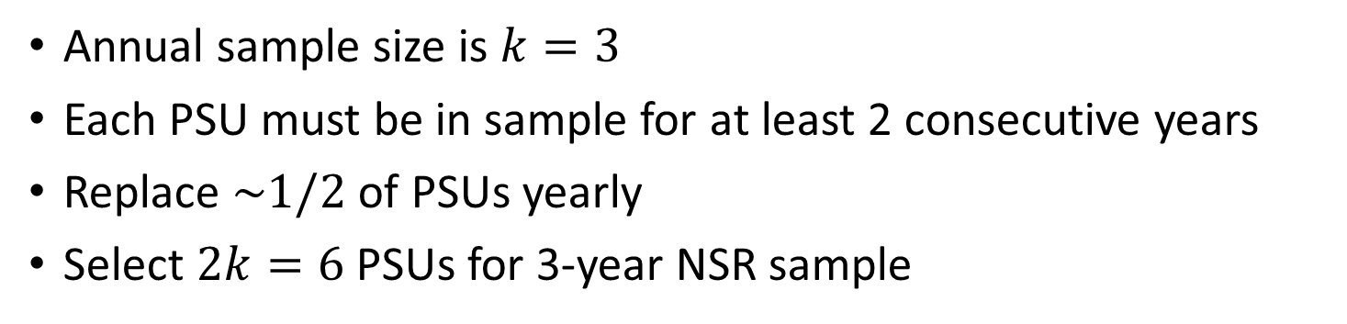
A Picture of NSR Cycling for One State
 | Year
Sample PSU | 2025 | 2026 | 2027 | 2028 | 2029 | 2030 | 2031 | 2032 | 2033 | 2034 | 2035 | 2036
A | x | x |  |  | x | x |  |  | x | x
B | x | x | x |  |  | x | x |  |  | x | x
C | x | x | x |  |  | x | x |  |  | x | x
D |  |  | x | x |  |  | x | x |  |  | x | x
E |  |  |  | x | x |  |  | x | x |  |  | x
F |  |  |  | x | x |  |  | x | x |  |  | x
Annual sample size is $k=3$
Each PSU must be in sample for at least 2 consecutive years
Replace $\sim 1/2$ of PSUs yearly
Select $2k=6$ PSUs for 3-year NSR sample

Slide 8
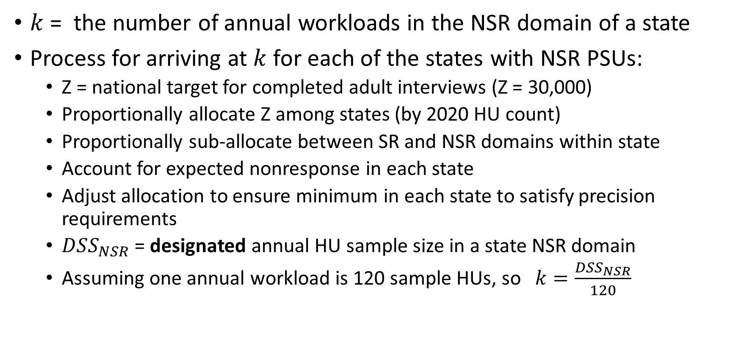
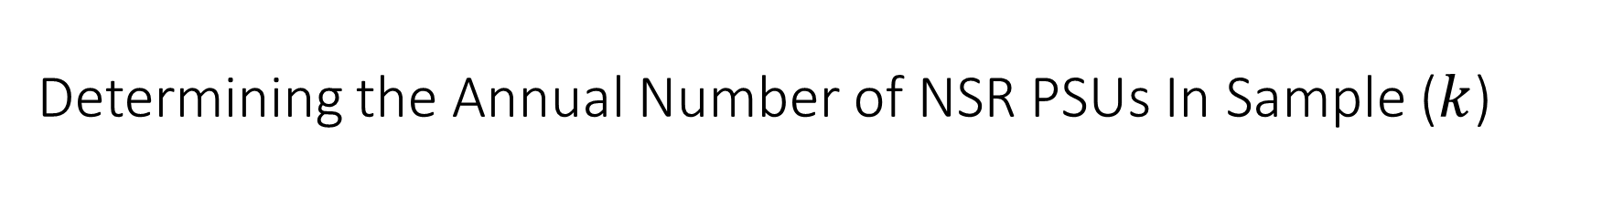
Determining the Annual Number of NSR PSUs In Sample ($k$)
$k$ = the number of annual workloads in the NSR domain of a state
Process for arriving at $k$ for each of the states with NSR PSUs:
Z = national target for completed adult interviews (Z = 30,000)
Proportionally allocate Z among states (by 2020 HU count)
Proportionally sub-allocate between SR and NSR domains within state
Account for expected nonresponse in each state
Adjust allocation to ensure minimum in each state to satisfy precision requirements
$DSS_{NSR}$ = designated annual HU sample size in a state NSR domain
Assuming one annual workload is 120 sample HUs, so $k=\frac{DSS_{NSR}}{120}$

Slide 9
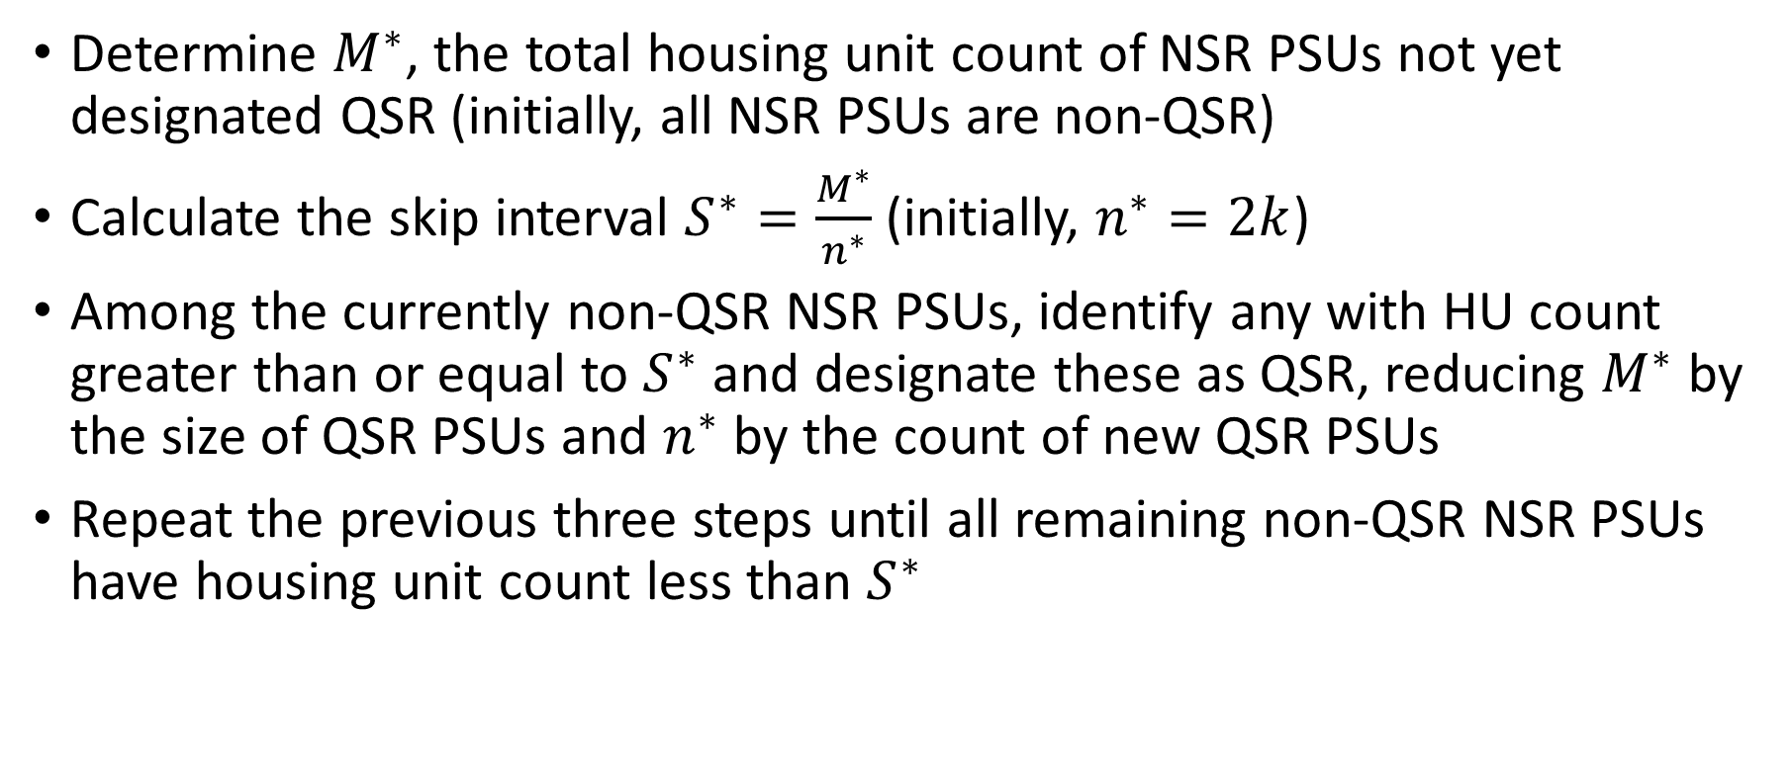
Determination of “quasi-SR” (QSR) PSUs, Skip Interval for Systematic PPSWOR Sampling
Determine $M^{∗}$, the total housing unit count of NSR PSUs not yet designated QSR (initially, all NSR PSUs are non-QSR)
Calculate the skip interval $S^{∗}=\frac{M^{∗}}{n^{∗}}$ (initially, $n^{∗}=2k$)
Among the currently non-QSR NSR PSUs, identify any with HU count greater than or equal to $S^{∗}$ and designate these as QSR, reducing $M^{∗}$ by the size of QSR PSUs and $n^{∗}$ by the count of new QSR PSUs
Repeat the previous three steps until all remaining non-QSR NSR PSUs have housing unit count less than $S^{∗}$

Slide 10
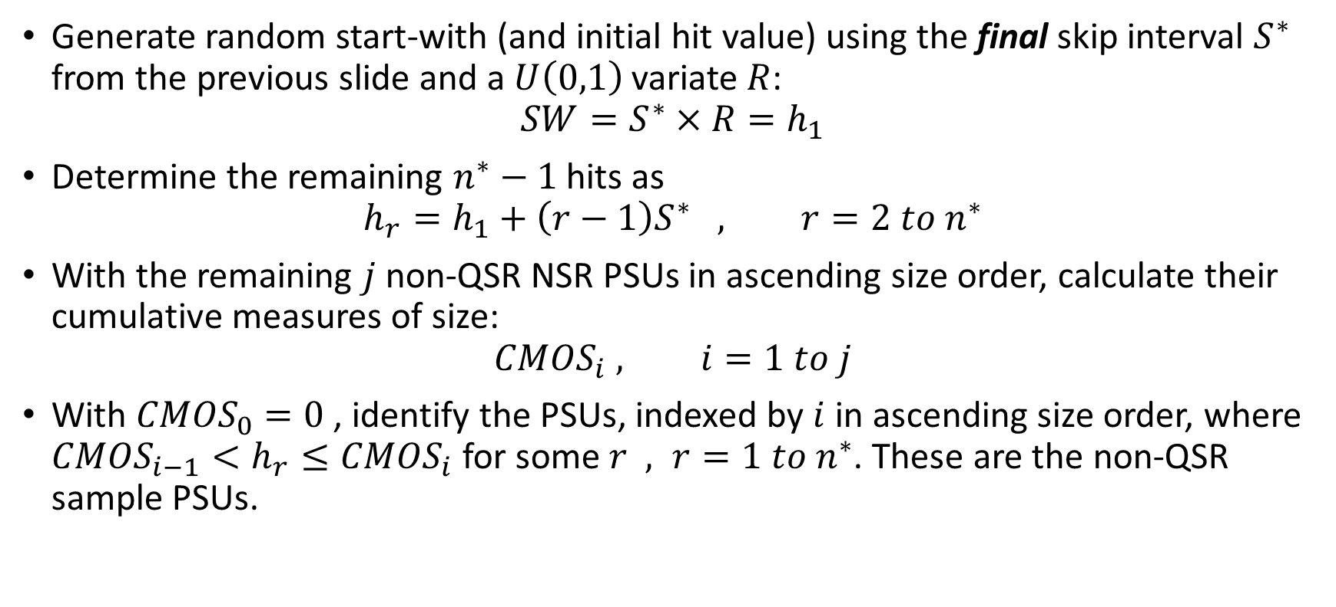
Selection of non-QSR PSU sample (if necessary)
Generate random start-with (and initial hit value) using the final skip interval $S^{∗}$ from the previous slide and a $U\left(0,1\right)$ variate $R$:
$$SW=S^{∗}×R=h_{1}$$
Determine the remaining $n^{∗}−1$ hits as
$$h_{r}=h_{1}+\left(r−1\right)S^{∗} , r=2 to n^{∗}$$
With the remaining $j$ non-QSR NSR PSUs in ascending size order, calculate their cumulative measures of size:
$$CMOS_{i} , i=1 to j$$
With ${CMOS}_{0}=0$ , identify the PSUs, indexed by $i$ in ascending size order, where $CMOS_{i−1}<h_{r}≤CMOS_{i}$ for some $r , r=1 to n^{∗}$. These are the non-QSR sample PSUs.

Slide 11
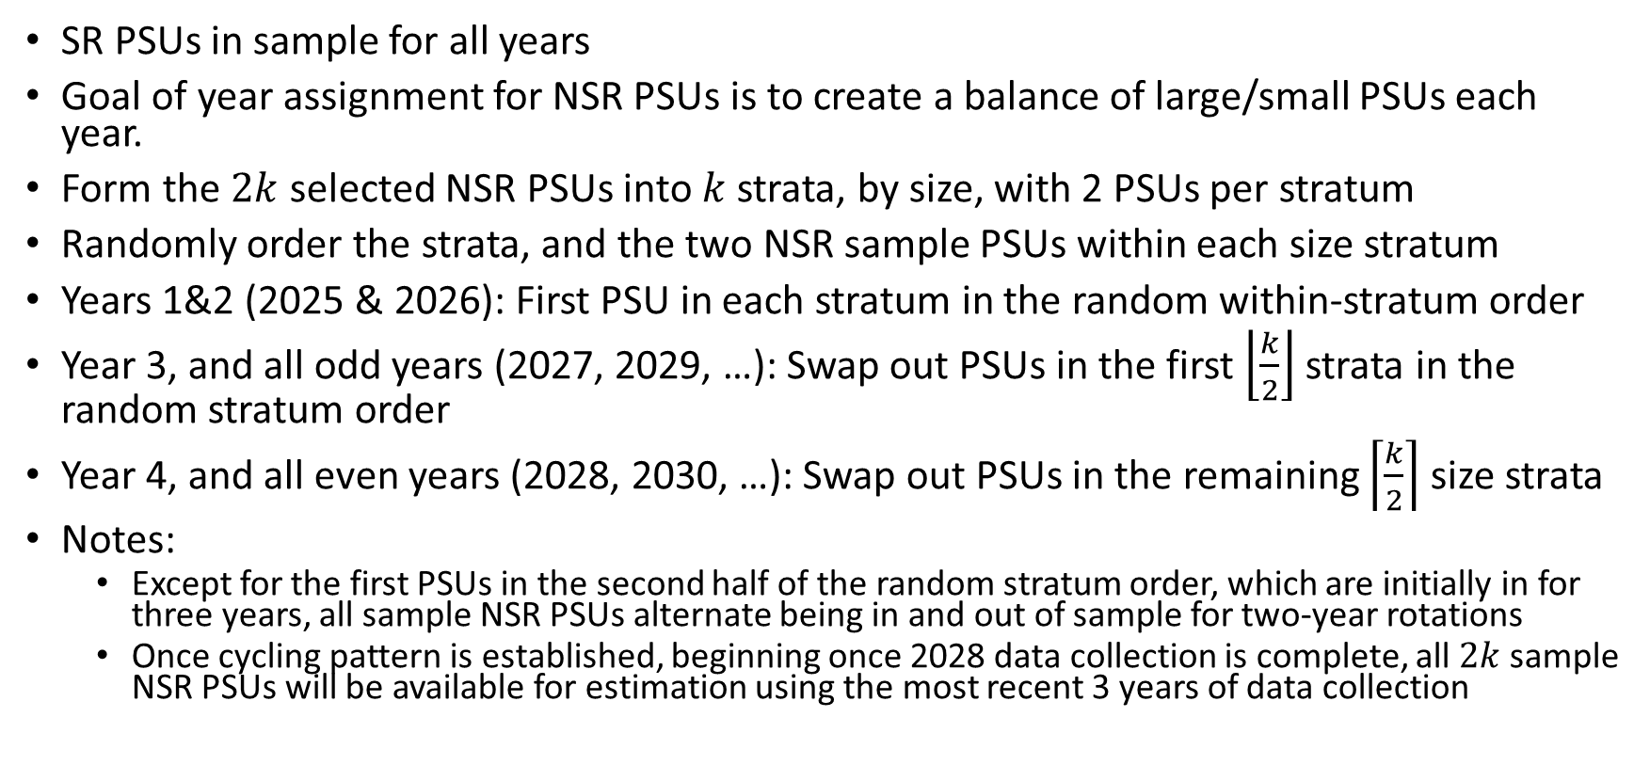
Sample-year assignment
SR PSUs in sample for all years
Goal of year assignment for NSR PSUs is to create a balance of large/small PSUs each year.
Form the $2k$ selected NSR PSUs into $k$ strata, by size, with 2 PSUs per stratum
Randomly order the strata, and the two NSR sample PSUs within each size stratum
Years 1&2 (2025 & 2026): First PSU in each stratum in the random within-stratum order
Year 3, and all odd years (2027, 2029, …): Swap out PSUs in the first $\left\lfloor \frac{k}{2}\right\rfloor$ strata in the random stratum order
Year 4, and all even years (2028, 2030, …): Swap out PSUs in the remaining $\left\lceil \frac{k}{2}\right\rceil$ size strata
Notes:
Except for the first PSUs in the second half of the random stratum order, which are initially in for three years, all sample NSR PSUs alternate being in and out of sample for two-year rotations
Once cycling pattern is established, beginning once 2028 data collection is complete, all $2k$ sample NSR PSUs will be available for estimation using the most recent 3 years of data collection

Slide 12
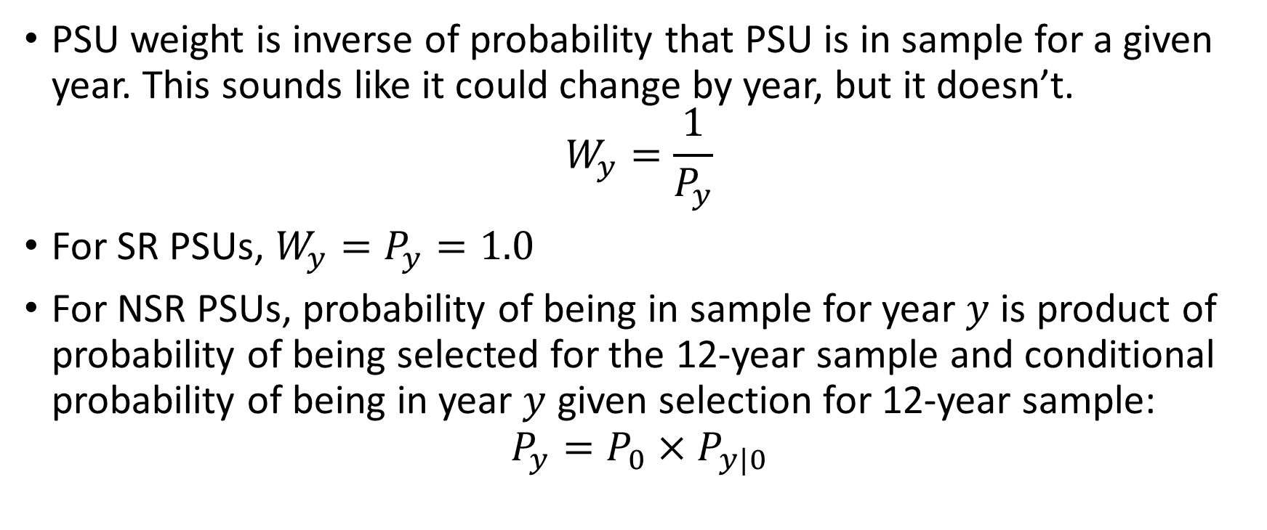
PSU Weights
PSU weight is inverse of probability that PSU is in sample for a given year. This sounds like it could change by year, but it doesn’t.
$$W_{y}=\frac{1}{P_{y}}$$
For SR PSUs, $W_{y}=P_{y}=1.0$
For NSR PSUs, probability of being in sample for year $y$ is product of probability of being selected for the 12-year sample and conditional probability of being in year $y$ given selection for 12-year sample:
$$P_{y}=P_{0}×P_{y|0}$$

Slide 13
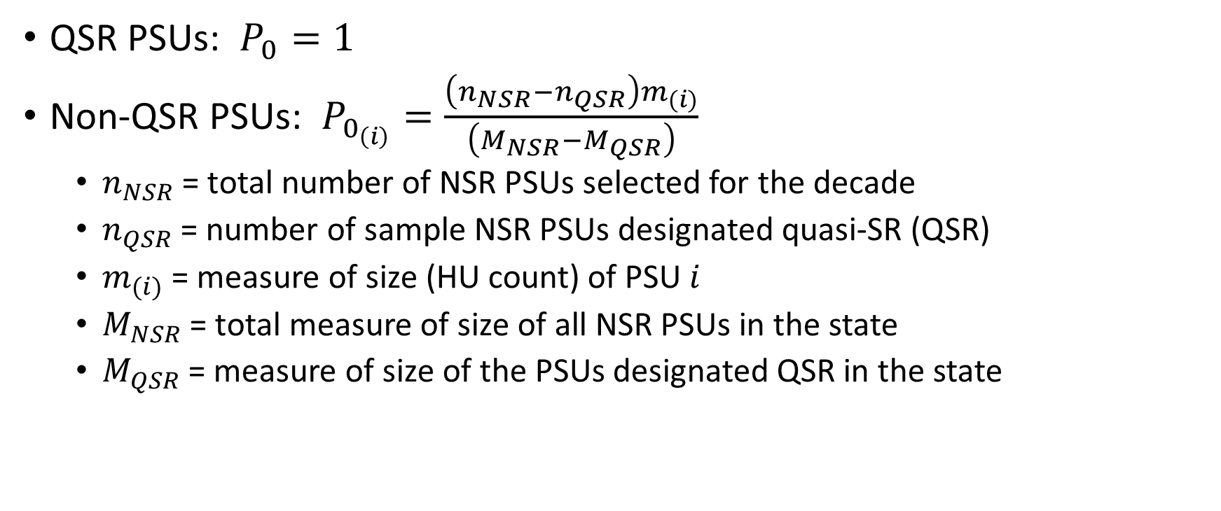
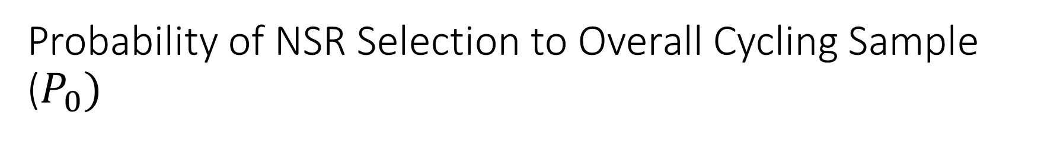
Probability of NSR Selection to Overall Cycling Sample ($P_{0})$
QSR PSUs: $P_{0}=1$
Non-QSR PSUs: $P_{0_{\left(i\right)}}=\frac{\left(n_{NSR}−n_{QSR}\right)m_{(i)}}{\left(M_{NSR}−M_{QSR}\right)}$
$n_{NSR}$ = total number of NSR PSUs selected for the decade
$n_{QSR}$ = number of sample NSR PSUs designated quasi-SR (QSR)
$m_{(i)}$ = measure of size (HU count) of PSU $i$
$M_{NSR}$ = total measure of size of all NSR PSUs in the state
$M_{QSR}$ = measure of size of the PSUs designated QSR in the state

Slide 14
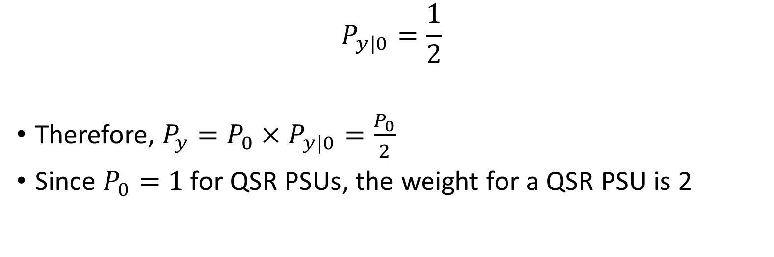
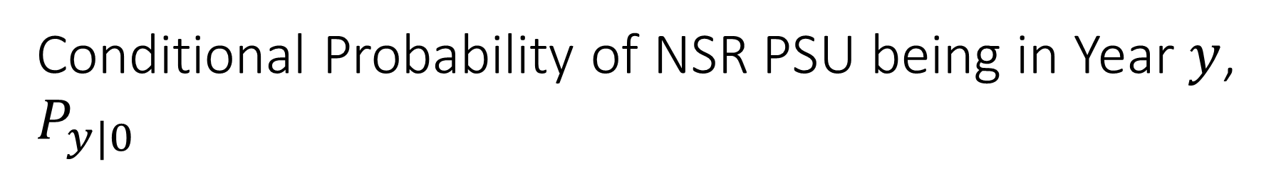
Conditional Probability of NSR PSU being in Year $y$, $P_{y|0}$
$$P_{y|0}=\frac{1}{2}$$
Therefore, $P_{y}=P_{0}×P_{y|0}=\frac{P_{0}}{2}$
Since $P_{0}=1$ for QSR PSUs, the weight for a QSR PSU is 2

Slide 15
Final Note
Since a motivation for cycling NSR PSUs is to increase the geographic coverage of each state with some NSR areas, why not maximize the number of sample NSR PSUs over the 12-year period?
First, state estimates will use at most 3 years of data, so there is no real benefit in extending the NSR sample size beyond what is needed for the 3-year cycling pattern, which is twice the annual NSR PSU sample size.
Second, we found that using a “maximal” 12-year NSR PSU sample can increase the overall sampling variance due to variability in PSU size, as compared with the minimal sample needed for cycling.

Slide 16
Questions?

